Slide 1
Cyber Security
Introduction to Cyber Security

Slide 2
•Unit V INTRODUCTION TO CYBER LAWS
•Introduction, Definition and origin, Cybercrime and Information security, Classification of Cybercrimes, The legal perspectives- Indian perspective, Global perspective, Categories of Cybercrime, Types of Attacks, a Social Engineering, Cyber stalking, Cloud Computing and Cybercrime.
•Unit VI TOOLS AND METHODS USED IN CYBERCRIME
•Introduction, Proxy servers and Anonymizers, Phishing, Password Cracking, Key-loggers and Spywares, Types of Virus, Worms, Dos and DDoS, SQL injection, Cybercrime and Legal perspectives, Cyber laws- Indian context, The Indian IT Act-Challenges, Amendments, Challenges to Indian Law and cybercrime Scenario in India, Indian IT Act and Digital Signatures. study of any two network security scanners: Nmap, Metasploit, OpenVAS, Aircrack, Snort, Wireshark, Nikito, Samurai, Safe 3 etc.

Slide 3
Cybercrime : Definition and Origin Of the word
Almost everyone is aware of the phenomenal growth of Internet
Given the unrestricted number of free websites, the Internet has undeniably opened a new way of exploitation known as cybercrime.
These activities involve the use of computers, the Internet, cyberspace and WWW.

Slide 4
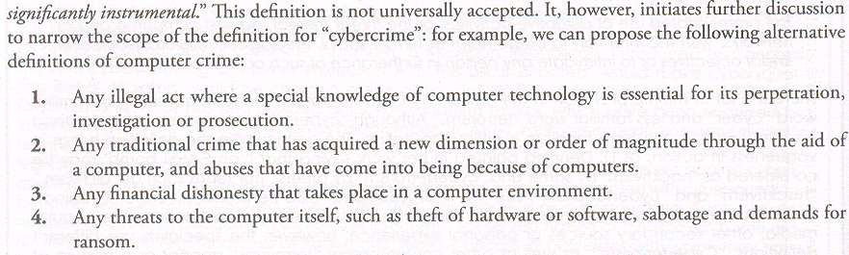

Slide 5
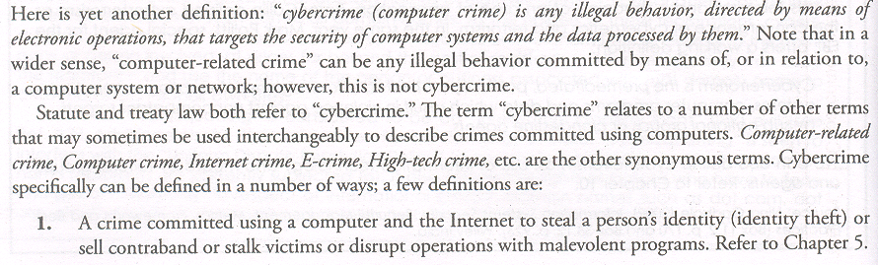

Slide 6
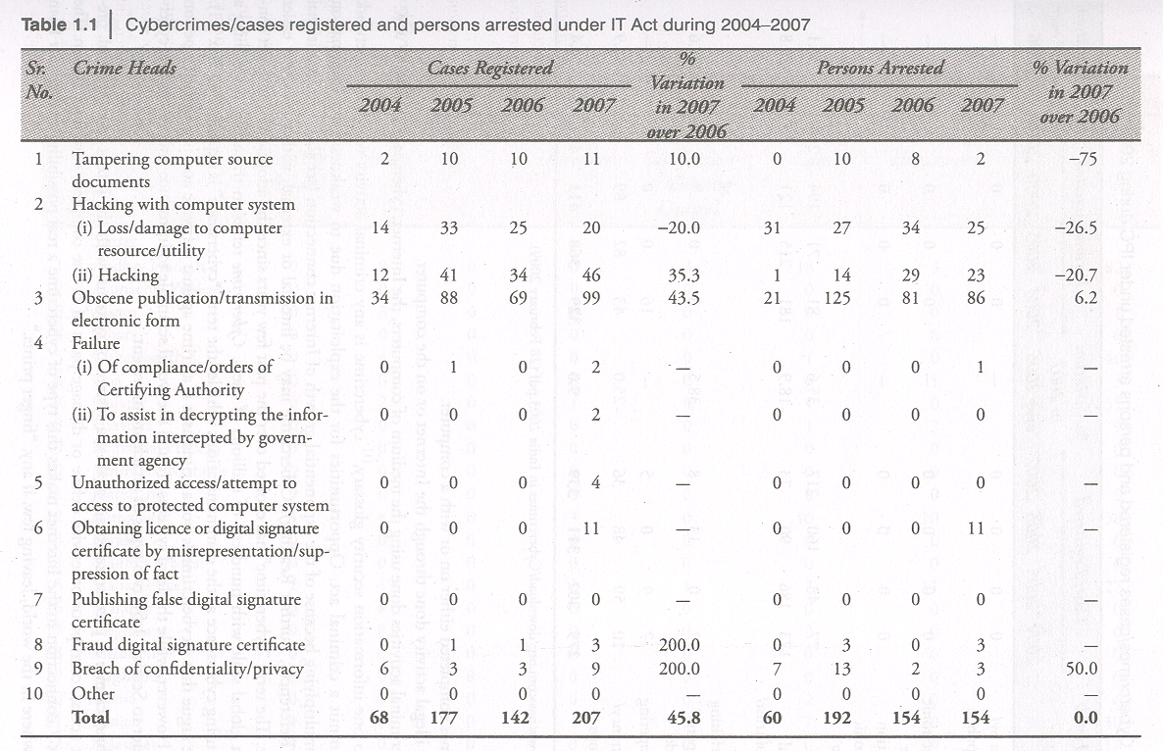

Slide 7
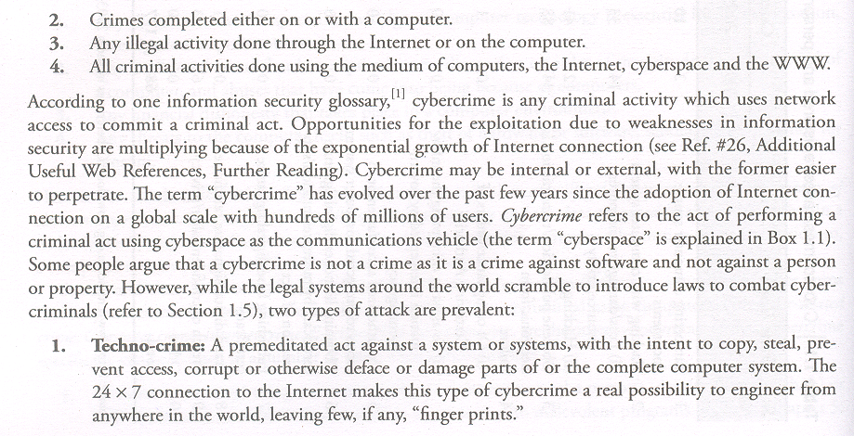

Slide 8
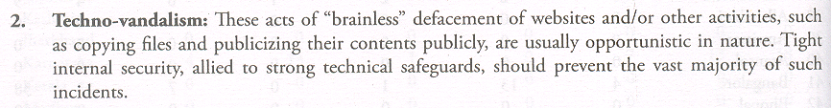
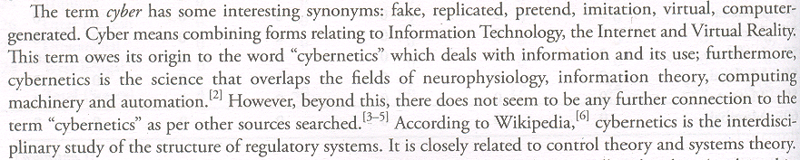

Slide 9
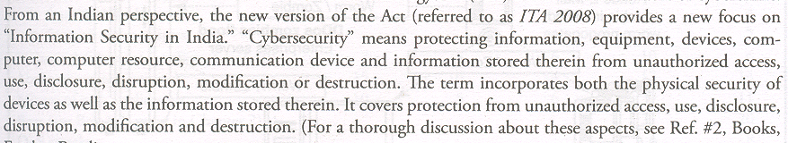

Slide 10
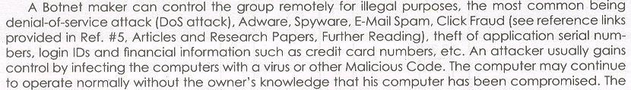

Slide 11
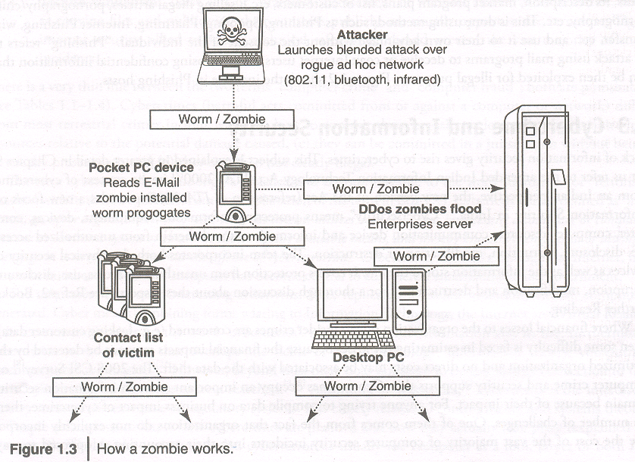

Slide 12
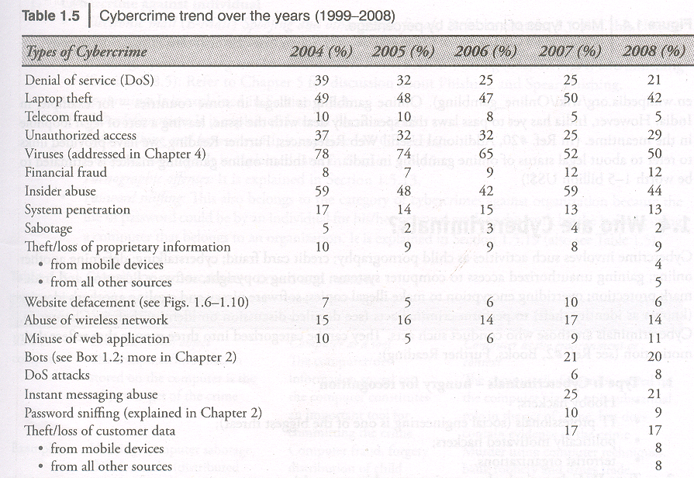

Slide 13
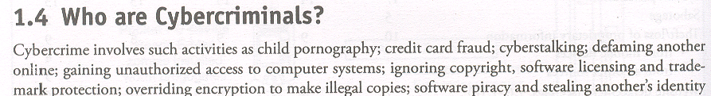
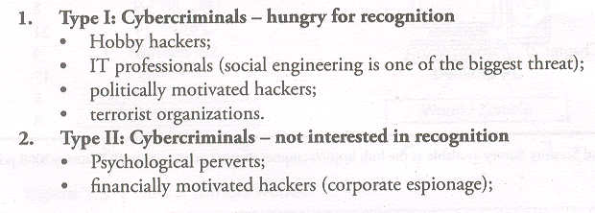

Slide 14
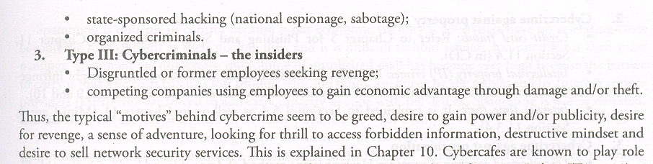

Slide 16
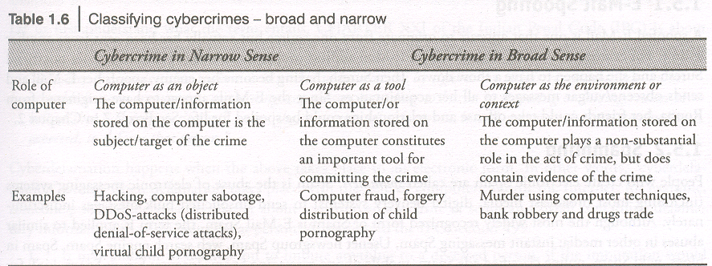

Slide 17
2.Cybercrimes against Property
Credit cards frauds
Intellectual Property (IP) Crimes
Internet Time Theft
3. Cybercrimes Against Organization

Slide 18
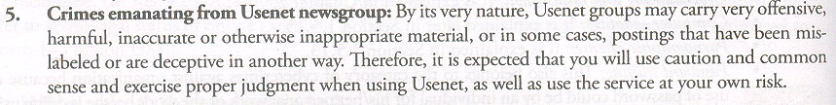

Slide 19


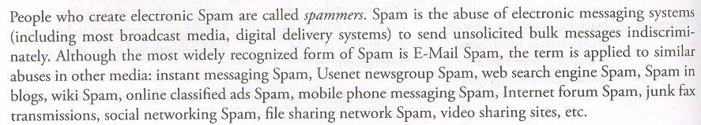

Slide 20
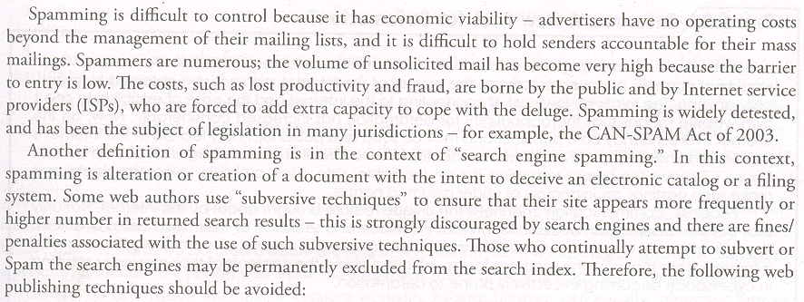

Slide 21
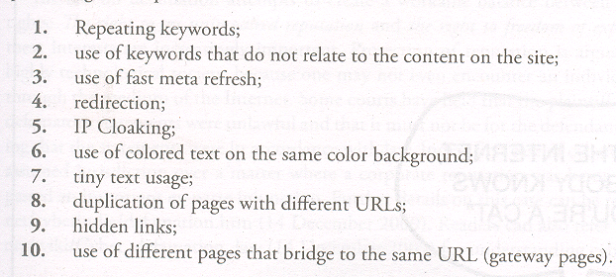
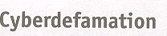


Slide 22
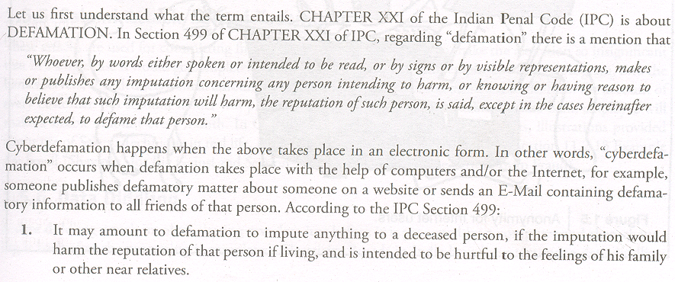

Slide 23
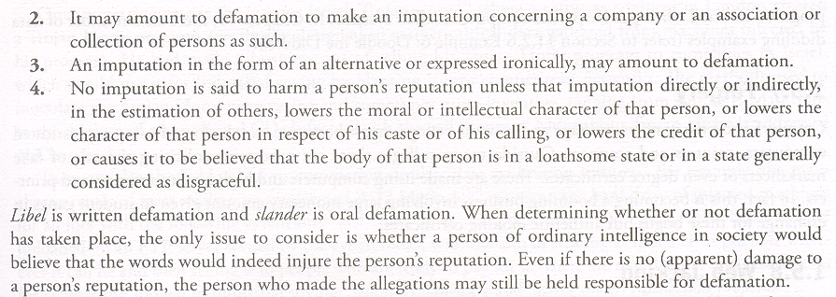

Slide 24
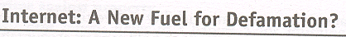
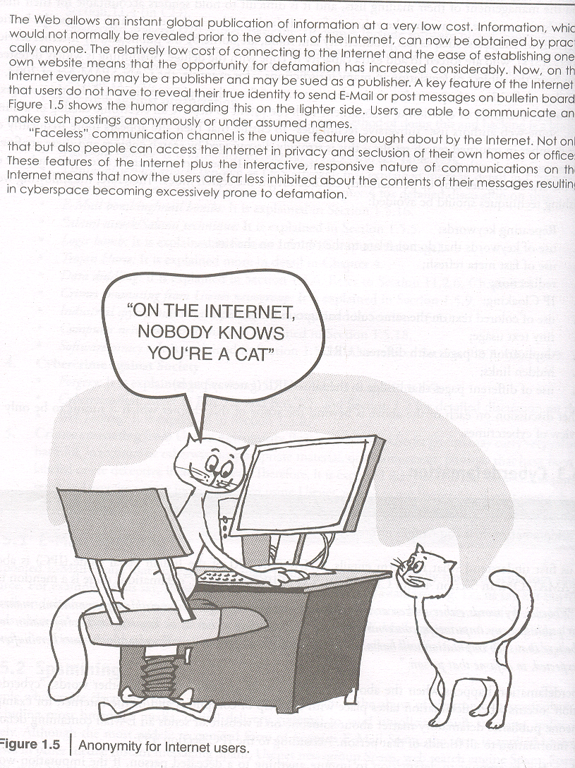

Slide 25
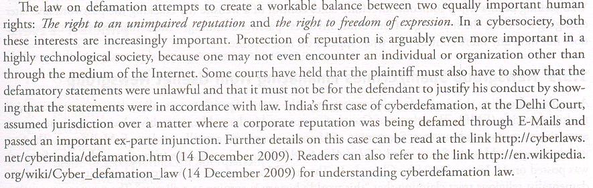

Slide 26

